Slide 1
fib Internacional Federation of Concrete
Model Code 2020
Hugo Corres
fib President
Prof. Technical University of Madrid, Spain
FHECOR Ingenieros Consultores
SE NIISK Kiev 2nd of May 2018

Slide 2
fib Internacional Federation of Concrete

Slide 3
CREATION OF fib
ceb
Euro-International
Committee for Concrete
Comité euro-internationale du béton
1953
fib
1998
International Federation
of Pre-stressing
Fédération internationale
de la précontrainte
1952

Slide 4
CREATION OF fib
UKRAINE
ceb
Euro-International
Committee for Concrete
Comité euro-internationale du béton
1953
fib
1998
International Federation
of Pre-stressing
Fédération internationale
de la précontrainte
Since its Creation
Since 1997
1952

Slide 5
MISSION AND OBJECTIVES OF THE fib
“To develop at an international level the study of scientific and practical matters capable of advancing the technical, economic, aesthetic and environmental performance of concrete construction.” Statutes of the fib
Stimulation of research and synthesis of findings
Transfer into design and construction practice
Dissemination by publications, conferences, etc.
Production of recommendations and codes
Dissemination of information to members

Slide 6
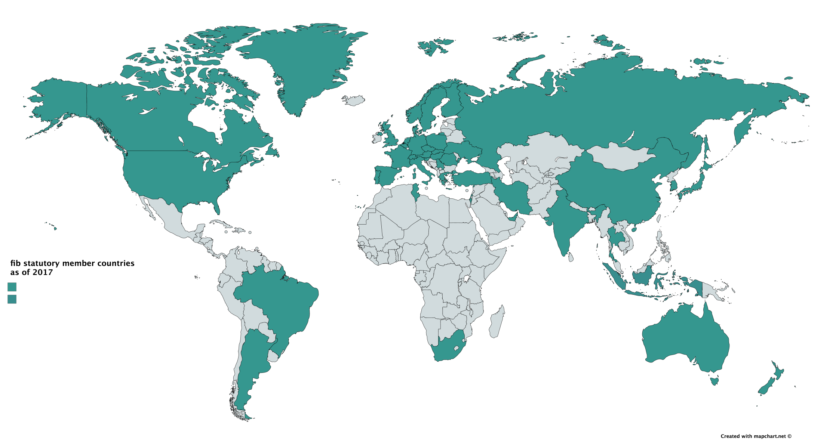
fib STATUTORY MEMBER COUNTRIES AS OF 2018
fib Statutory Member Countries
China - India - Australia – New Zealand - Iran - Turkey - Ukraine - Romania - Hungary - Slovakia - Poland – Czech Republic - Austria - Switzerland - Spain - Italy - Norway - Sweden - Finland - Canada – United States - Argentina – South Africa - Russia - Tunisia - Portugal - Thailand - Japan - Israel – Saudi Arabia - Germany - Belgium - Netherlands - Denmark – United Kingdom - Serbia - Greece - Slovenia - Brazil – South Korea - France - Luxembourg - Cyprus – Lebanon - UAE
Notes:
Ordenar por orden alfabetico

Slide 7
THE fib’s STRUCTURE
General Assembly
Commissions
Task Groups
Working Parties
Presidium
Secretariat
Technical Council
Planning & execution
Materials & production
COM1
Concrete structures
COM2
Analysis & design
COM3
Existing Concrete Structures
COM4
Concrete & concrete technology
COM5
Reinforcement
COM6
Prefabrication
Sustainability & durability
Education & publications
COM7
Sustainability
COM8
Durability
COM9
Dissemination of knowledge
COM10
Model Codes

Slide 8
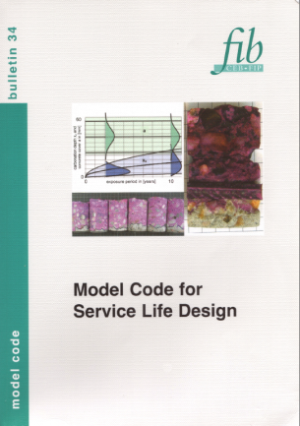
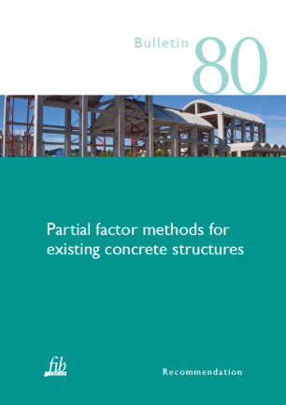
RESULTS OF COMMISSIONS AND TASK GROUPS ARE PUBLISHED AS fib BULLETINS
Technical reports
State-of-the-art reports
Textbooks
Manuals or guides
Recommendations
Model Codes

Slide 9
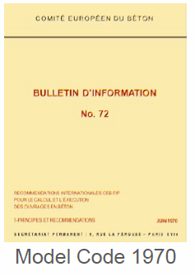


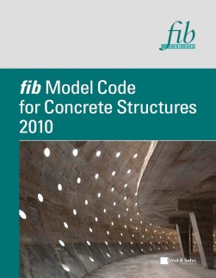

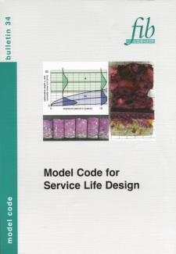
fib (CEB/FIP) MODEL CODES
1978
Model Code
Model Code
Model Code
1978
1985
2006
1970
1980
1990
2000
2010
CEB Bull. 165 Seismic Design
fib Bull. 34 Service Life Design

Slide 10
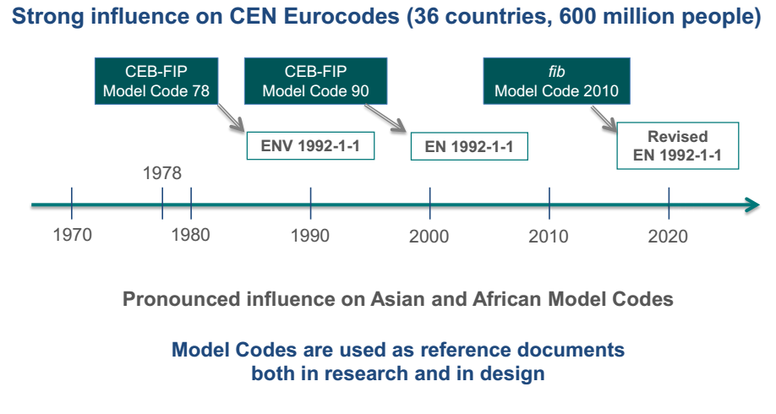
IMPACT OF fib (CEB/FIP) MODEL CODES

Slide 11

fib EVOLUTION OF MODEL CODES
New initiative
1978
Model Code
2020
Model Code
Model Code
Model Code
Model Code
1978
1985
2006
1970
1980
1990
2000
2010
2020
CEB Bull. 165 Seismic Design
fib Bull. 34 Service Life Design
Notes:
Hay que arreglar el model code de 1970

Slide 12
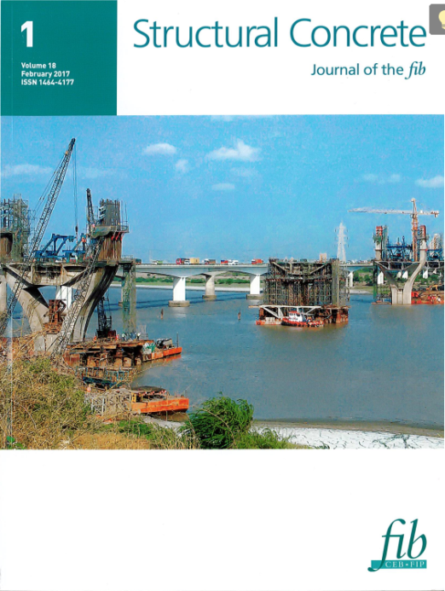



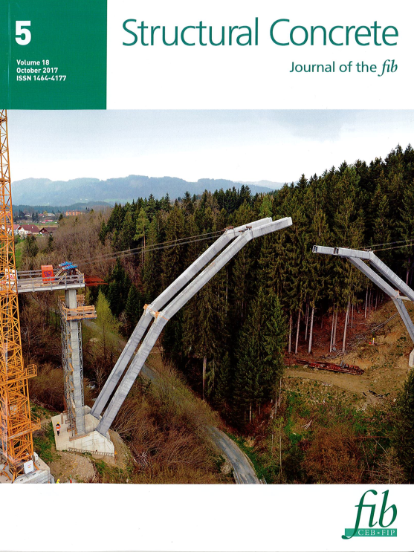

Structural Concrete Journal of the fib
Impact factor 2017: 1.424
6 issues from 2017
Notes:
Corregir el indice de impacto

Slide 13



Upcoming fib Symposia and Congresses
2018: Congress.
Melbourne. Australia
2019: Symposium
Krakow. Poland
2020: Symposium
Shanghai. China
2018: PhD Symposium
Prague. Czech Republic

Slide 14
fib Awards and honours
Freyssinet Medal
Recognizes outstanding technical contributions in the field of structural concrete
Medal of Merit
Recognizes outstanding contributions to structural concrete and to the fib
Honorary Life Members
Recognizes significant personal contributions to the work of the fib
Awards for Outstanding Concrete Structures
International recognition for concrete structures which demonstrate the versatility of concrete as a structural medium
Achievement Award for Young Engineers
Recognizes engineers younger than 40 years old

Slide 15
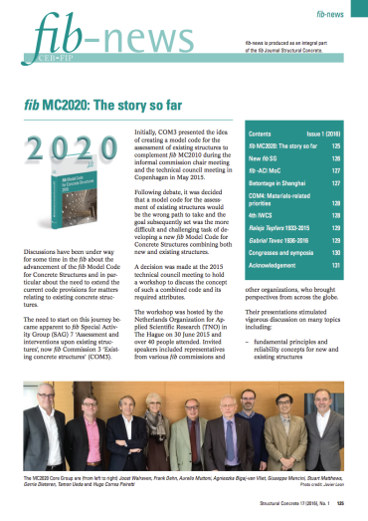


Staying informed about the fib
fib-news
  Quarterly newsletter published in the fib’s Structural Concrete journal
e-newsletter
  Sent by e-mail every 6 weeks
Follow-us on social media
Website: www.fib-international.org
e-mail: info@fib-international.org

Slide 16


fib International Cooperation
Memoranda of cooperation signed in 2015 with:
  ACI
  RILEM
Promote coordination between the organizations
Arrange relevant joint activities
Ensure effective coverage of fields of interest
Find suitable solutions for joint publications

Slide 17
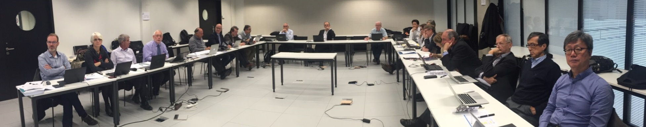
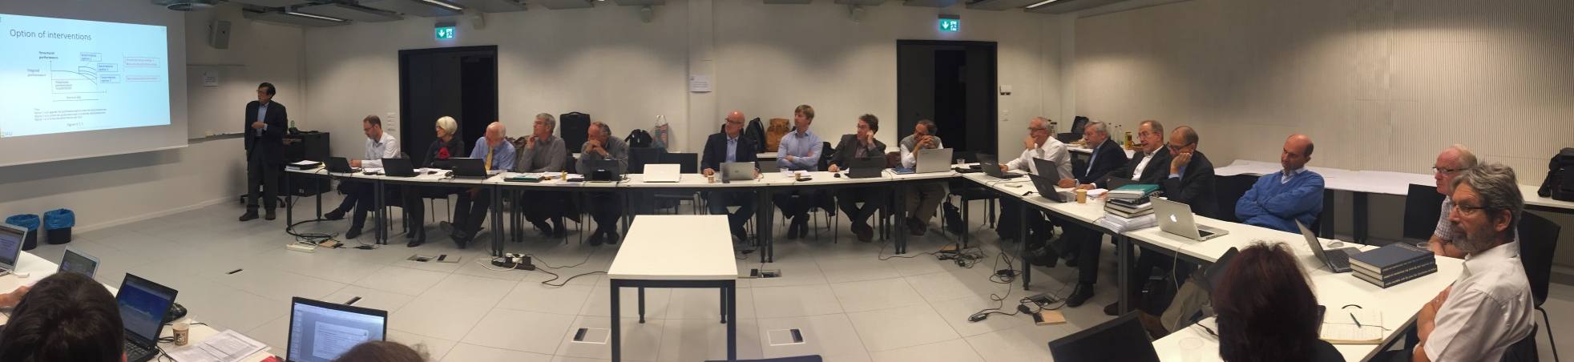
The WAY OF WORKING of the fib
COM10 – First Meeting. Lausanne, 15 October 2016 at the EPFL

Slide 18
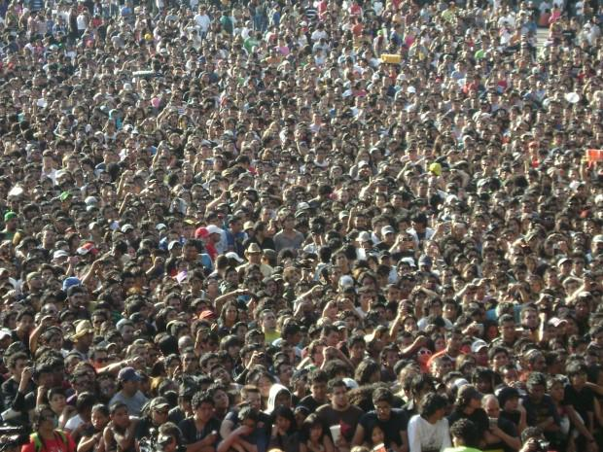
fib
Notes:
Gente
To finish my presetation of fib, I would like to enphasises that fib is a great group of expert, from the all different continents, working together to emprove concrete in a voluntary way and, even if it is not something we think normaly, helpingo to improve the life of our comunity.
I have to say that i feel very proud to be president of such an important and generous group of people. Please joint us, we need a lot of energy to make reality our ambisions.

Slide 19
From Model Code 2010 to Model Code 2020

Slide 20
fib (CEB/FIP) MODEL CODES
1978
Model Code
Model Code
Model Code
1978
1985
2006
1970
1980
1990
2000
2010
CEB Bull. 165 Seismic Design
fib Bull. 34 Service Life Design

Slide 21
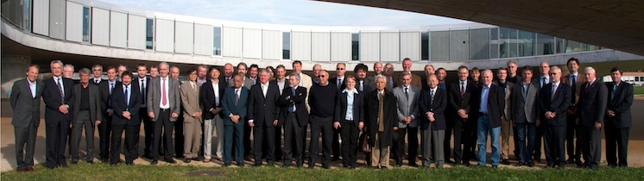
fib MC2010
11th fib General Assembly voting on Model Code 2010, Lausanne, 29 October 2011

Slide 22

Preface
Notations
PART I: PRINCIPLES
PART II: DESIGN INPUT DATA
PART III: DESIGN
PART VI: CONSTRUCTION
PART V: CONSERVATION AND DISMANTLEMENT

Slide 23
fib EVOLUTION OF MODEL CODES
New initiative
1978
Model Code
2020
Model Code
Model Code
Model Code
Model Code
1978
1985
2006
1970
1980
1990
2000
2010
2020
CEB Bull. 165 Seismic Design
fib Bull. 34 Service Life Design
Notes:
Hay que arreglar el model code de 1970

Slide 24
THE fib’s STRUCTURE
General Assembly
Commissions
Task Groups
Working Parties
Presidium
Secretariat
Technical Council
Planning & execution
Materials & production
COM1
Concrete structures
COM2
Analysis & design
COM3
Existing Concrete Structures
COM4
Concrete & concrete technology
COM5
Reinforcement
COM6
Prefabrication
Sustainability & durability
Education & publications
COM7
Sustainability
COM8
Durability
COM9
Dissemination of knowledge
COM10
Model Codes

Slide 25
DECISION OF THE TECHNICAL COUNCIL, June 2016
COM10
Model Codes
Chair: Gordon Clark
T10.1
MC2020
Convener:
Stuart Matthews
T10.2
Concrete production and technology
Convener: NN
T10.3
Execution and dismantling
Convener: NN
T10.4
Fire Design
Convener: NN
T10.5
……..
Convener: NN
new
MC2020
Core Group
to be disbanded
overarching
document/code
when necessary and/or opportunity arises

Slide 26
fib MC2020
MC 2020 will be a single, merged structural code for new and existing structures
It has to present general and more rational models more, removing all heritage from previous empirical design rules (MC2010 was an important step forward, but further steps are possible, and needed)
It will be an operational model code and oriented towards practical needs
It will recognize the needs of engineering communities around the world. MC 2020 has to be a real International Code.

Slide 27
fib MC2020
MC 2020 will be a single, merged structural code for new and existing structures
It has to present more general and more rational models, removing all heritage from previous empirical design rules (MC2010 was an important step forward, but further steps are possible, and needed)
It will be an operational model code and oriented towards practical needs
It will recognize the needs of engineering communities around the world. MC 2020 has to be a real International Code.

Slide 28
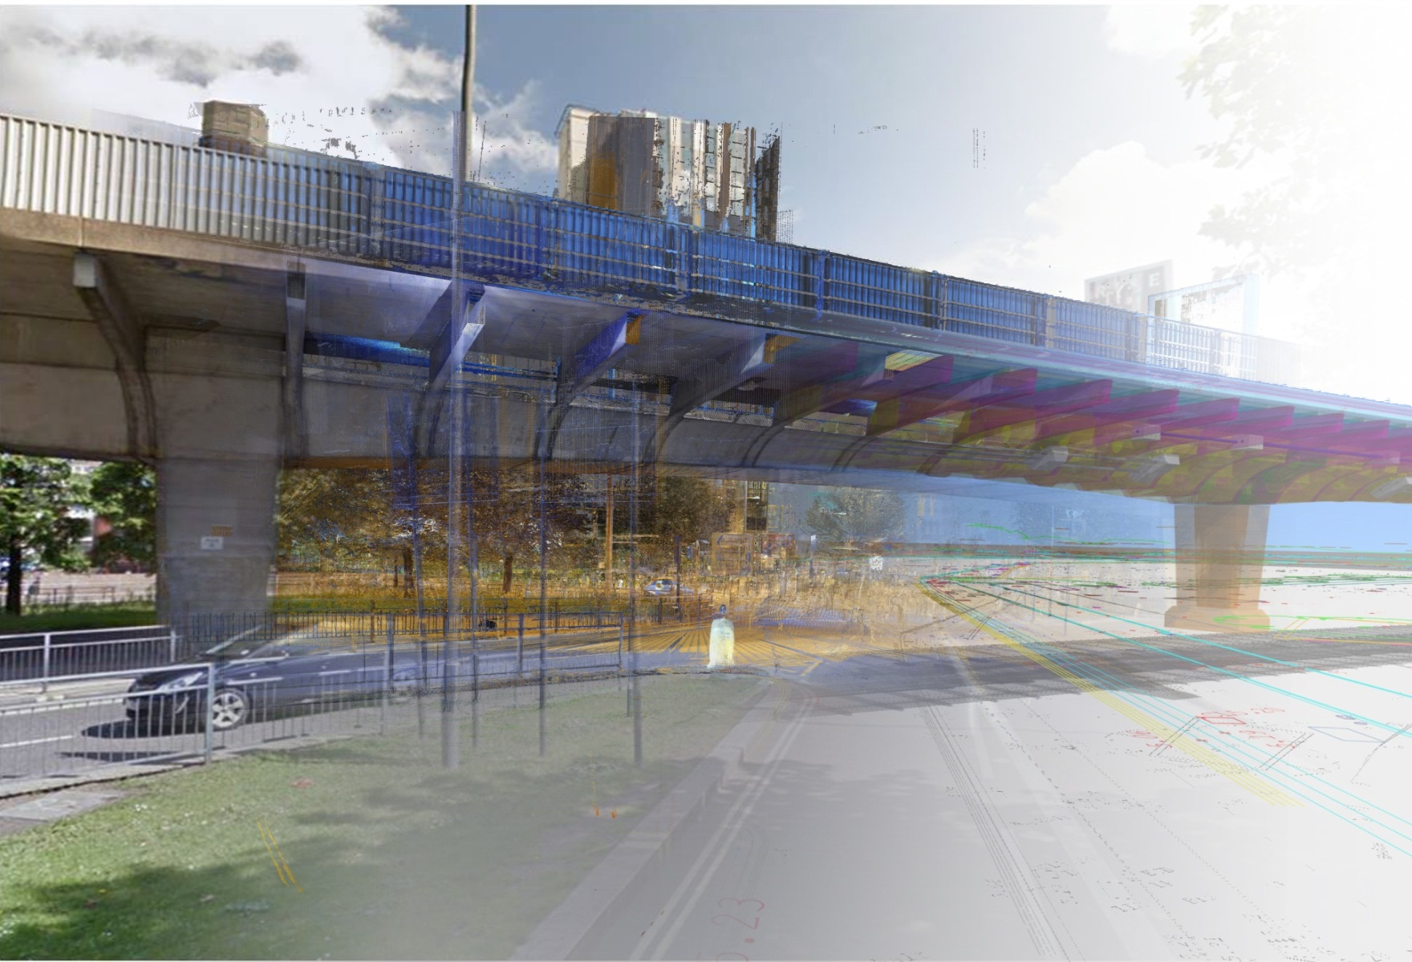
Advancing fib model code for concrete structures
Dr Steve Denton
Head of Bridges and Ground Engineering, WSP Parsons Brinckerhoff
Visiting Professor, University of Bath
Chairman, CEN/TC 250

Slide 29
1ST GENERATION
Design Standards
Assessment Standards

Slide 30
1ST GENERATION
Issues:
Failure to recognise differences between design and assessment
Typically results in conservative assessment results
Insufficient account taken of actual materials, detailing and tolerances
Design Standards
Assessment Standards

Slide 31
2ND GENERATION
Issues:
Duplication of content
Omission of content
Problematic for interventions (modification of existing structures)
Design Standards
Assessment Standards

Slide 32
FUTURE GENERATION – A NEW PHILOSOPHY?
General Provisions / Models
Application for Design
Application for interventions / modification
Application for Assessment

Slide 33
PRINCIPLES FOR DEVELOPMENT OF UNIFIED MODEL CODE
General provisions / models are common for design, assessment and interventions
General provisions / models are explicit about conditions that need to be satisfied for them to be applicable (e.g. performance of detailing, deformation capacity)
  Application parts set out how such conditions can be satisfied
General provisions / models allow account to be taken of actual materials, detailing and tolerances that may be encountered on existing structures
  Application parts can simplify for specific uses (e.g. design cases)

Slide 34
FUTURE GENERATION?
General Provisions / Models
Application for Design
Application for interventions / modification
Application for Assessment

Slide 35
FUTURE GENERATION – SUCCESS?
General Provisions / Models
Application for Design
Application for interventions / modification
Application for Assessment

Slide 36
FUTURE GENERATION – FAILURE?
General Provisions / Models
Application for Design
Application for interventions / modification
Application for Assessment

Slide 37

Need for advancements of fundamental principles and reliability concepts for existing structures
(a personal view)
Aurelio Muttoni, Member of fib COM 2 The Hague, 30th June 2015
École Polytechnique Fédérale de Lausanne, Switzerland

Slide 38


Introduction
Mosque–Cathedral of Córdoba (Spain)
Built by the Muslims in the 8th century using columns and other structural members from a previous Christian church built by the Visigoths
Converted to a Roman Catholic church and insertion of a cathedral nave in the 16th century
Builders (and engineers) are dealing since centuries with existing structures !

Slide 39
Design of new structures and assessment of existing structures are fundamentally different?
new structures
(future structures)
existing structures
“There exists a fundamental difference between the design of a new structure and the assessment of existing structures”

Slide 40
Design of new structures and assessment of existing structures are fundamentally different?
new structural members as parts of existing structures
new structures
(future structures)
existing structures
retrofitting
New structures and existing structures are not always easy to distinguish (overlap region is very important for engineer's activity)

Slide 41
Design of new structures and assessment of existing structures are fundamentally different?
Main differences between design of new structures and assessment of existing structures :
Different level of knowledge about the structure (assumptions done during design can be verified more or less easily in situ, C30/37 for design, f_{ck}=35.7 MPa for assessment)
For assessment of an existing structure, ULS is more important than SLS (it is only normally sufficient to investigate on its ultimate strength, since the SLS behaviour can be usually checked in situ by inspections and accounting for the experience of end-users, provided that the actions remain unchanged)
Different economic impact if a requirement is not fulfilled (cost of retrofitting)
Deterioration….

Slide 42
Design of new structures and assessment of existing structures are fundamentally different?
Main differences between design of new structures and assessment of existing structures :
Design approach in case of nonlinearity (concrete cracking and steel yielding)
Methods inspired by Lower Bound Theorem of Limit Analysis in case of design
Calculating internal forces
M [kNm]
Checking sections
χ [1/m]
Muttoni A. , Fernández Ruiz M., Niketić F., Design versus assessment of concrete structures using stress fields and strut-and-tie models, ACI-Journal, accepted for publication, 2015

Slide 43
Design of new structures and assessment of existing structures are fundamentally different?
Main differences between design of new structures and assessment of existing structures :
Approach for assessment in case of nonlinearity (in case of sufficient deformation capacity)
Methods should be more inspired by Upper Bound Theorem of Limit Analysis or non-linear analysis in case of assessment
q_{R}
M [kNm]
χ [1/m]
Muttoni A. , Fernández Ruiz M., Niketić F., Design versus assessment of concrete structures using stress fields and strut-and-tie models, ACI-Journal, accepted for publication, 2015

Slide 44
fib MC2020
MC 2020 will be a single, merged structural code for new and existing structures
It has to present more general and more rational models, removing all heritage from previous empirical design rules (MC2010 was an important step forward, but further steps are possible and needed)
It will be an operational model code and oriented towards practical needs
It will recognize the needs of engineering communities around the world. MC 2020 has to be a real International Code.

Slide 45

Need for advancements of models for existing structures
Some ideas for the next fib-Model Code
Aurelio Muttoni, Member of fib COM 2 The Hague, 30th June 2015
École Polytechnique Fédérale de Lausanne, Switzerland

Slide 46
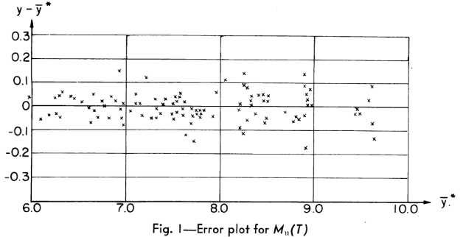
Mechanical models vs. empirical equations, the case of bending
Ritter, W., 1899, Die Bauweise Hennebique, Schweizerische Bauzeitung, Zurich
Zsutty T.C., Ultimate Strength Behaviour Study by Regression Analysis of Beam Test Data, ACI Structural Journal, May 1963

Slide 47
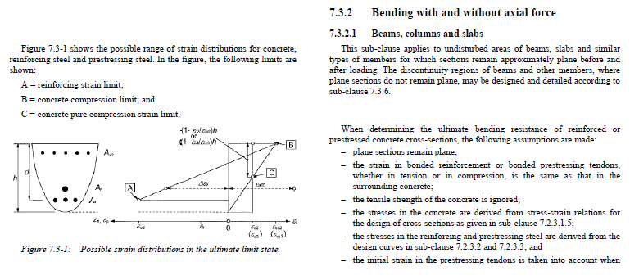
Mechanical models vs. empirical equations, the case of bending
Valid for:
Several cross sections
With axial force
With prestressing
Several reinforcement layers
Different concrete types
Can be easily adapted for unforeseen cases (non-metallic reinforcement, …)

Slide 48

Mechanical models vs. empirical equations, the case of shear in members without transverse reinforcement
Zsutty, T. C., 1968, Beam shear strength prediction by analysis of existing data, ACI Journal, November 1968, Vol. 65, No. 11, pp. 943-951

Slide 49
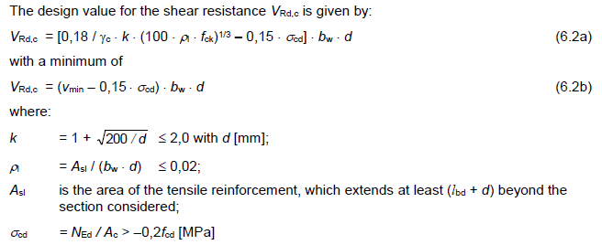
Members without transverse reinforcement: current situation in EC2 (MC90)
Zsutty equation

Slide 50
Members without transverse reinforcement: current situation
Size effect (empirical)
Zsutty equation (fully empirical)
Normal force effect (fully empirical)
Minimum value (background ?)

Slide 51
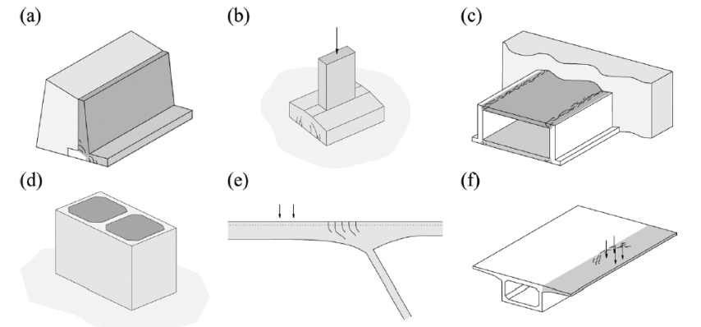
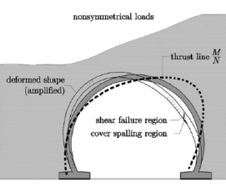
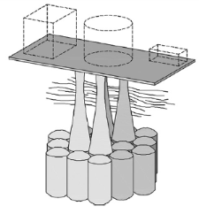
Influence of research work ⬄ practical needs
?⬄?
Influence of load distribution, static system, variable depth, member curvature, concentrated loads near linear supports….

Slide 52

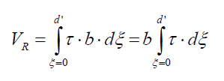


Mechanical models vs. empirical equations, the case of shear in members without transverse reinforcement
Simplification
Practical needs
Testing
Research
Understanding and modelling
Codes
Generalization
and not
Complication !

Slide 53
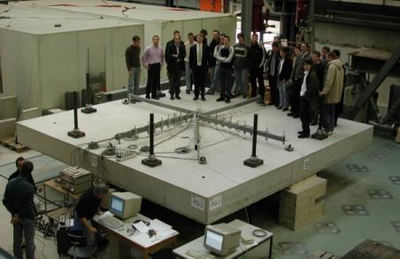
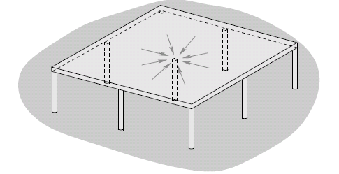
Influence of research work ⬄practical needs
Punching of flat slabs
About 90% of punching shear tests have been performed on interior slab-columns connections
Almost all tests are performed on isolated specimens
Code provisions are mostly related to interior slab-columns ;
They have been calibrated on these tests!
1 interior column,
4 edge columns
4 corner columns

Slide 54
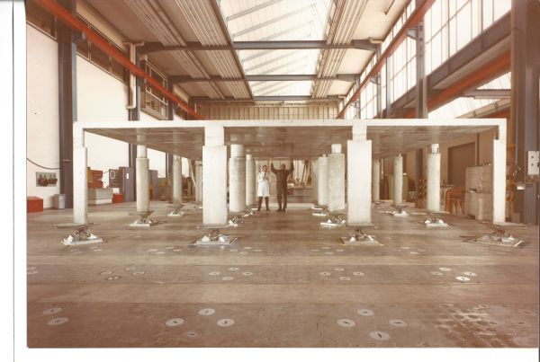
Influence of slab continuity on punching shear strength
Courtesy EMPA/H.Lippuner, 1977

Slide 55
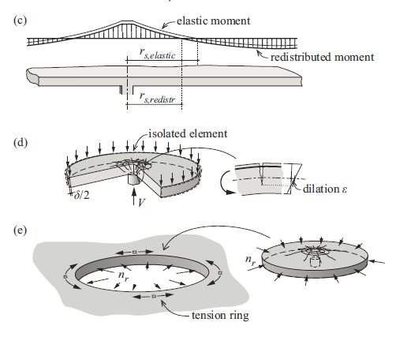
Influence of slab continuity on punching shear strength
Einpaul, J. , Fernández Ruiz, M., Muttoni, A., Influence of moment redistribution and compressive membrane action on punching strength of actual flat slabs, Engineering structures, 2015

Slide 56
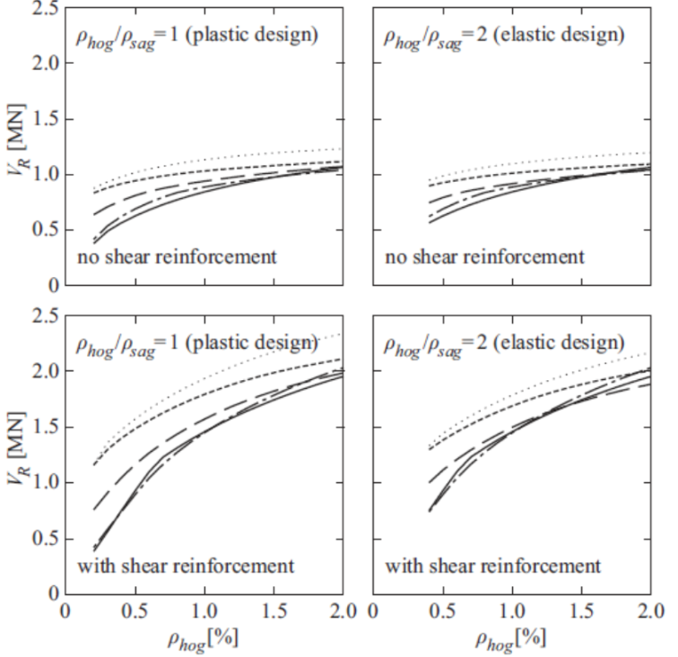
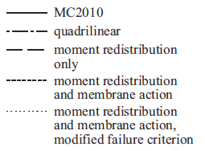
Influence of slab continuity on punching shear strength
hidden safety
Einpaul, J. , Fernández Ruiz, M., Muttoni, A., Influence of moment redistribution and compressive membrane action on punching strength of actual flat slabs, Engineering structures, 2015

Slide 57
fib MC2020
MC 2020 will be a single, merged structural code for new and existing structures
It has to present more general and more rational models, removing all heritage from previous empirical design rules (MC2010 was an important step forward, but further steps are possible, and needed)
It will be an operational model code and oriented towards practical needs
It will recognize the needs of engineering communities around the world. MC 2020 has to be a real International Code.

Slide 58
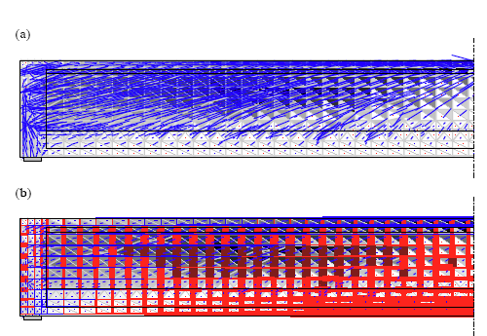
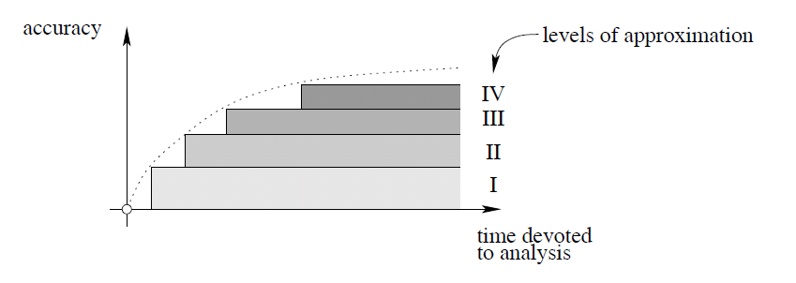
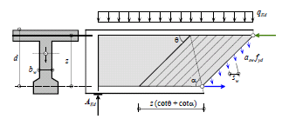
Levels of approximation approach (MC 2010)
assessment of critical existing structures
design of special cases
typical design
preliminary design, non governing limit state
Muttoni, A., Introduction to SIA 262 code, Documentation SIA D 0182, Zürich, 2003
Muttoni A., Fernández Ruiz M. , Levels-of-approximation approach in codes of practice , Structural Engineering International, 2012
Muttoni A., Fernández Ruiz M., The levels-of-approximation approach in MC 2010: application to punching shear provisions, Structural Concrete, 2012

Slide 59
fib MC2020
MC 2020 will be a single, merged structural code for new and existing structures
It has to present more general and more rational models, removing all heritage from previous empirical design rules (MC2010 was an important step forward, but further steps are possible, and needed)
It will be an operational model code and oriented towards practical needs
It will recognize the needs of engineering communities around the world. MC 2020 has to be a real International Code.

Slide 60
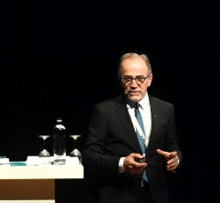

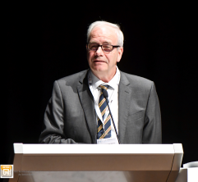

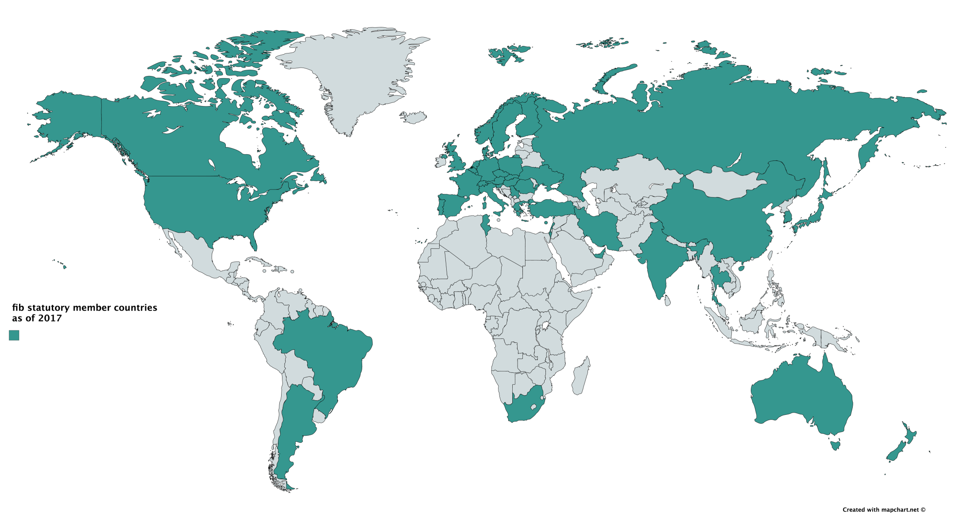
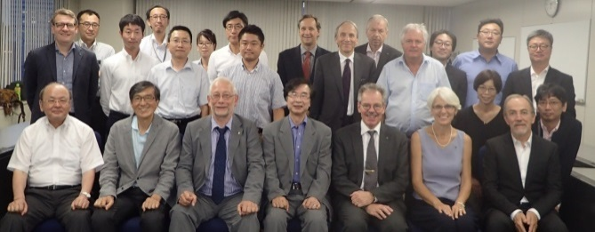

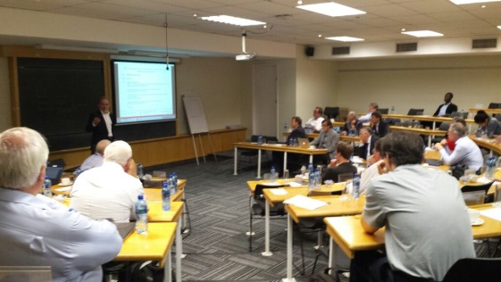

MC2020 Initiative – Global involvement
Interactive Session on MC2020 - Maastricht, 14 June 2017
PCI Workshop Denver Feb 2018
JCI-fib Joint Workshop Japan Sept 2016
ABECE Abicic Workshop Brasil Sept 2017
Workshop Australia-Adelaida Oct 2017
Workshop Cape Town Nov 17 - 24 2016

Slide 61

TIMELINE OF fib MC2020
Kick-off meetings of fib Commission 10: & TG10.1: MC2020 in Lausanne, Switzerland, 14-15 October 2016
fib Commission 10 & TG10.1: MC2020 in Delft, Nederland, 10-11 March 2017
fib Commission 10 & TG10.1: MC2020 in Barcelona, Spain ,11-12 December 2017
fib Commission 10 & TG10.1: MC2020 in Lausanne, Switzerland, 13-14 April 2018

Slide 62
T10.1 ACTION GROUPS
  AG1: Databases Bayrak
  AG2: Shear, punching & other combined actions Muttoni
  AG3: Bond Plizzari
  AG4: Durability (under auspices of COM8) Papworth
  AG5: Detailing COM2 to advise
  AG6: Fire Taerwe
  AG7: Seismic Design & Assessment Fardis
  AG8: Numerical analysis (NLFEM) Hendriks & Monti
  AG9: Testing & SHM: Bergmeister & Strauss
  AG10: Robustness / Accidental actions: Caspeele & Mancini
  AG11: Fatigue Ueda
  AG12: Impact & Explosion Di Prisco

Slide 63
Preface
Notations
PART I: PRINCIPLES
PART II: DESIGN INPUT DATA
PART III: DESIGN
PART VI: CONSTRUCTION
PART V: CONSERVATION AND DISMANTLEMENT

Slide 64

New initiative
SCOPE AND TERMINOLOGY
PART I: BASIC PRINCIPLES
PART II: ACTIONS ON STRUCTURES
PART III: DESIGN INPUT DATA
PART IV: DESIGN AND ASSESSMENT PROCEDURES
PART V: EXECUTION
PART VI: THROUGH-LIFE MANAGEMENT, DISMANTLEMENT AND REUSE
Model Code
2020

Slide 65
MODEL CODE 2020: CONTENTS PROPOSAL
MC2010 General | MC2020 General
1. Scope | 1. Scope
2. Terminology | 2. Terminology

Slide 66
MODEL CODE 2020: CONTENTS PROPOSAL
MC2010 Part I: Basic Principles | MC2020 Part I: Basic Principles
3. Basic principles Performance-based approach principles Perfomance requirements for serviceabilty and structural safety Performace criteria for sustainability Life cycle quality management 4. Principles of structural design Design situations, strategies and methods. Safety formats | 3. Sustainability perspective
 | 4. Through-life management and care
 | 5. Performance-based approach
 | 6. Principles of structural design and assessment
 | 7. Principles of execution
 | 8. Principles of dismantlement and reuse
 | 9. Principles of quality and information management

Slide 67


Sustainable development meets present needs without compromising the needs of future generations.
Our Common Future or Brundtland Report, 1987
Gro Harlem Brundland former Norway’s Minister of the Environment (1974-79).

Slide 68
ENVIRONMENTAL
SOCIAL
SOCIO-ENVIRONMENTAL JUSTICE
USE OF RESOURCES
SAFETY
CONTAMINATION
COMFORT
WASTE
CREATIVITY
SUSTAINABILITY
ECO-EFFICIENCY
SOCIAL INCLUSION
ECONOMICAL
COST
MAINTENANCE
DURABILITY

Slide 69


Slide 70


Slide 71
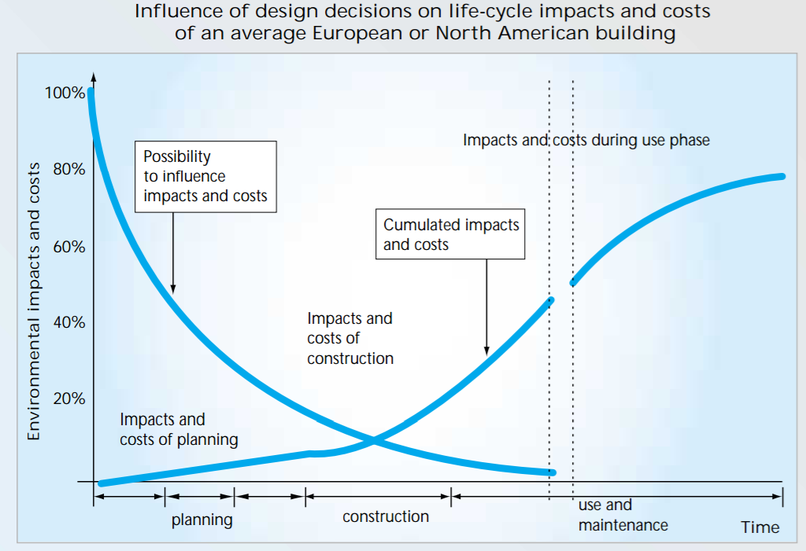
Sustainability perspective
Source: Kohler, N. et al “Life-cycle analysis of the built environment”. Sustainable building construction

Slide 72
MODEL CODE 2020: CONTENTS PROPOSAL
MC2010 Part I: Basic Principles | MC2020 Part I: Basic Principles
3. Basic principles Performance-based approach principles Perfomance requirements for serviceabilty and structural safety Performace criteria for sustainability Life cycle quality management 4. Principles of structural design Design situations, strategies and methods. Safety formats | 3. Sustainability perspective
 | 4. Through-life management and care
 | 5. Performance-based approach
 | 6. Principles of structural design and assessment
 | 7. Principles of execution
 | 8. Principles of dismantlement and reuse
 | 9. Principles of quality and information management

Slide 73
MC2020 for Concrete Structures. Safety philosophy based on reliability concept
Safety philosophy based on reliability concept
  Reliability concepts extended and updated to cover new and existing structures, considering risk and reliability differentiation to distinguish between :
    new and existing structures - where different safety levels are adopted due to economics but with minimum levels due to human safety requirements
    countries’/regions’ specific economic conditions

Slide 74
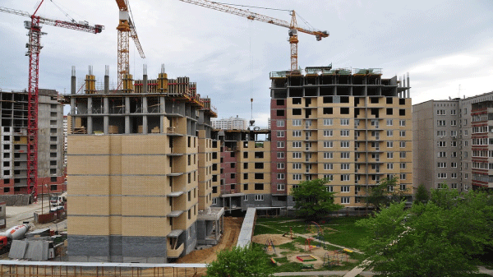
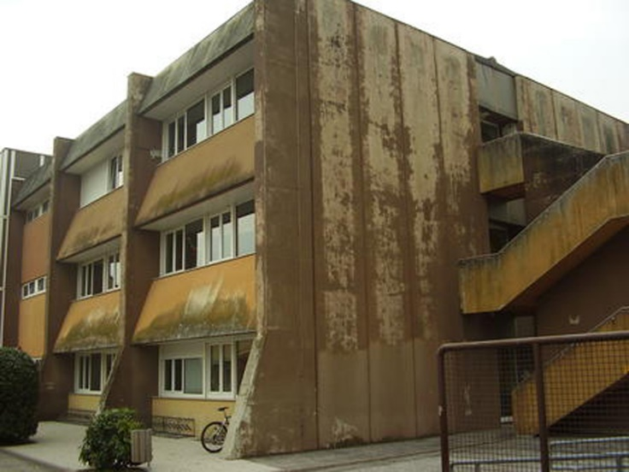
MC2020 for Concrete Structures. Safety philosophy based on reliability concept
The target reliability values (β) may be reduced in existing structures compared to the new ones

Slide 75


SAFETY FORMAT FOR NEW AND EXISTING STRUCTURES
PCI fib Workshop, Denver, 21 February 2018 prof.dr.ir. Raphaël Steenbergen

Slide 76
TARGET RELIABILITY

Slide 77
COST OPTIMISATION
Cost optimal reliability
Cost
C_{build}
Human safety
e.g. IR=10⁻⁵

Slide 78

new
existing
costs
costs
P_{f} D
P_{f} D
C_{build}
C_{upgrade}
3.8
β
2.5
3.3
β
Existing probability * damage
3 levels in MC 2020:
β_{new} : for design
β_{up} : while upgrading
β₀ : decision upgrading yes/no

Slide 79
PARTIAL FACTORS: RESISTANCE AND LOAD FACTORS

Slide 80

Should we adjust the mechanical model?
What is the residual steel area in case of corrosion?
What is the amount of reinforcement?
What is the actual value of the concrete cover?
Were is the carbonation front located?
NO EXACT ANSWERS
!!!
What is the concrete strength?
Has corrosion already started?
Where is the reinforcement located?
80

Slide 81
FIB BULLETIN 80
fib bulletin 80
“Partial factor methods for existing concrete structures ”
Prepared by fib COM3, TG3.1
Published 2017

Slide 82
PARTIAL FACTOR METHOD FOR EXISTING STRUCTURES
Coherent
Easy-to-use, graphical representation
Straigthforward
Compatible with the framework of the Eurocodes
Enabling to account for alternative safety levels, remaining working life, reference period and additional information and not bound to specific choices for them
Design value method and adjusted partial factor method

Slide 83
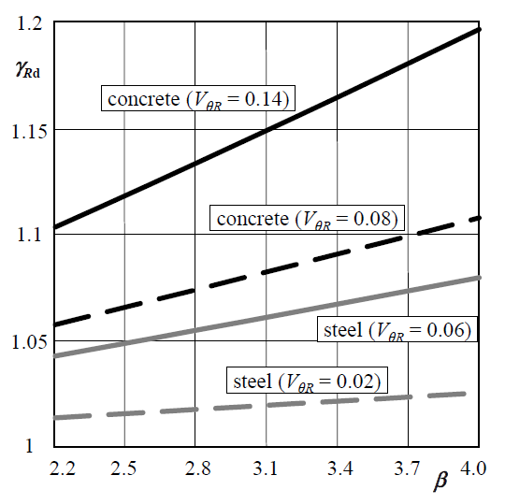
THE DESIGN VALUE METHOD (DVM)
PARTIAL FACTORS FOR MATERIAL PROPERTIES
γ_{M} = γ_{Rd} γ_{m}
Model uncertainty
Also available for
permanent loads
variable loads:
bending, axial load, shear
both for favourable and unfavourable loads
Considerable geometric uncertainties
(lack of drawings, …)

Slide 84
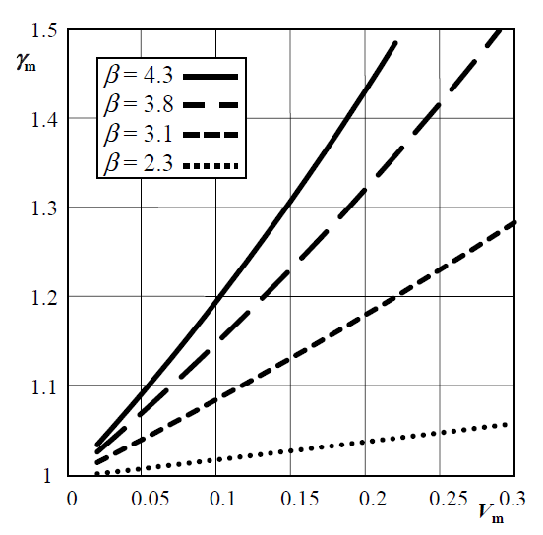
THE DESIGN VALUE METHOD (DVM)
PARTIAL FACTORS FOR MATERIAL PROPERTIES
LN distr.
γ_{M} = γ_{Rd} γ_{m}

Slide 85
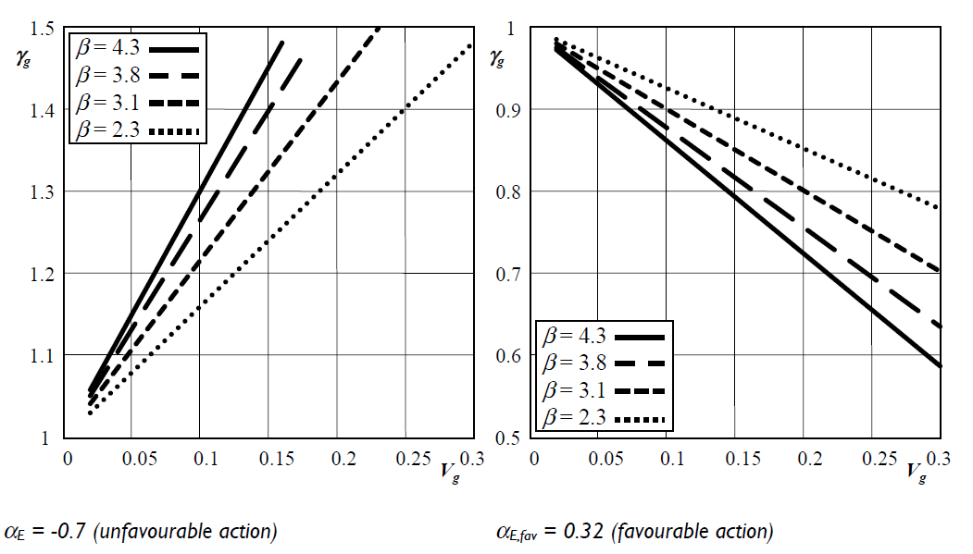
DVM: PARTIAL FACTORS FOR PERMANENT ACTIONS
γ_{G} = γ_{Ed,G} γ_{g}
²

Slide 86
THE ADJUSTED PARTIAL FACTOR METHOD
where ω_{γ} (the so-called adjustment factor) should be able to incorporate:
− alternative target reliability levels (economic considerations)
− updated information with respect to the uncertainty of distributional characteristics
− γ_{X} is for new
β_{t}
t_{r}
_{Vx}
APFM
always relative to EC/MC for new
fully compatible

Slide 87
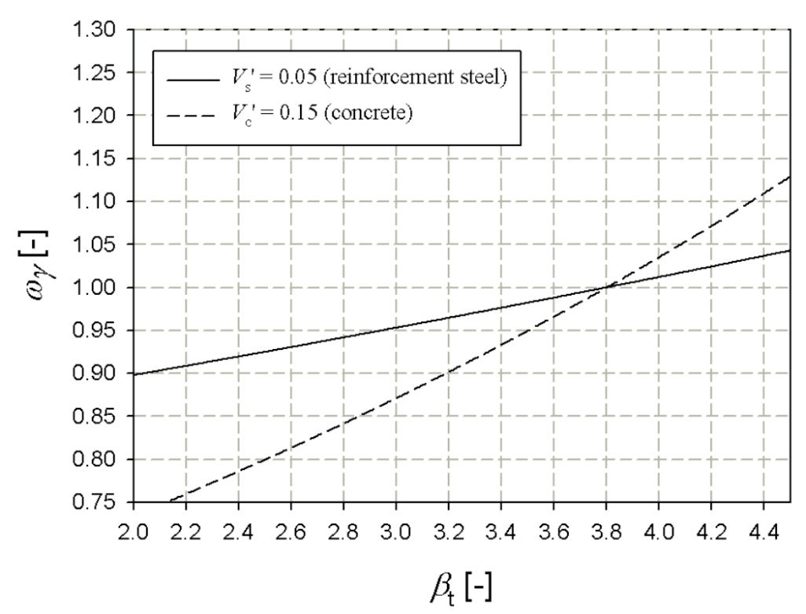
APFM: ADJUSTMENT FACTORS FOR MATERIAL PROPERTIES
α_{R} = 0.8, β’ = 3.8, V_{x}”/ V_{x}’ = 1
V’ ↓ → reduced influence
Reinforcement steel
Concrete

Slide 88
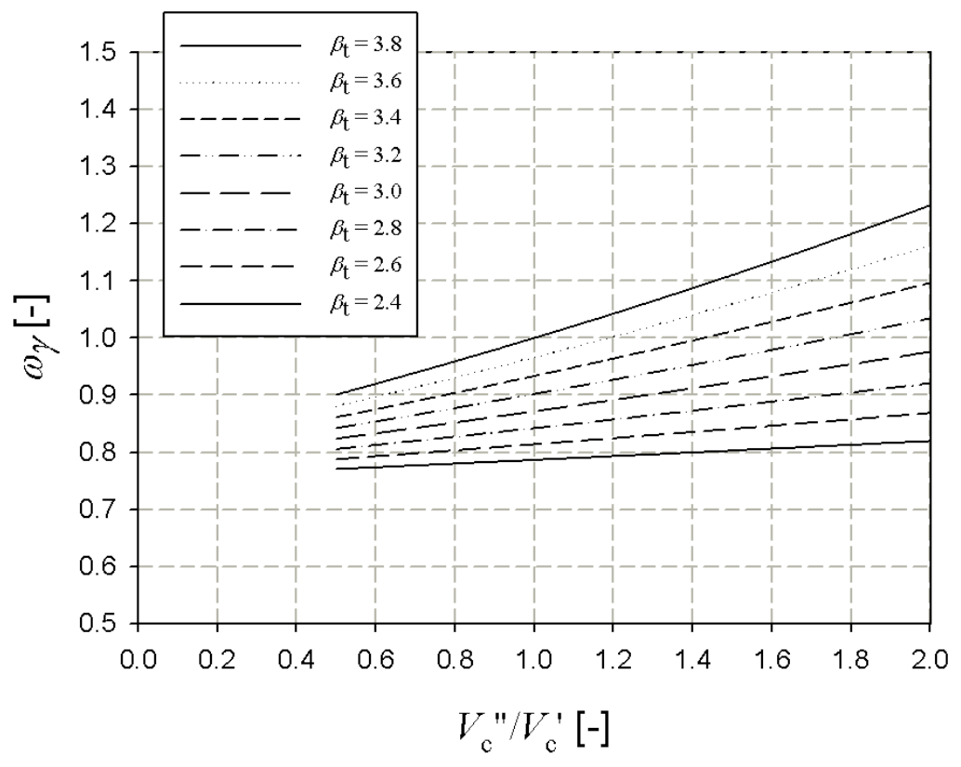
APFM: ADJUSTMENT FACTORS FOR MATERIAL PROPERTIES
X_{rep} = X_{k} (α_{R} = 0.8, β’ = 3.8, δ’ = 0.15)
β_{t} ↓

Slide 89
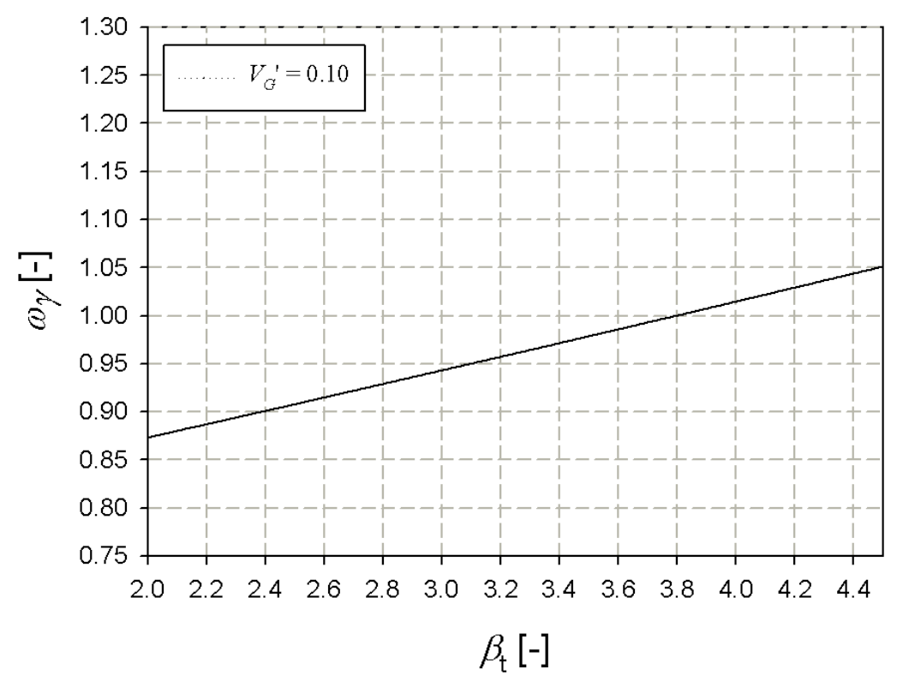
APFM: ADJUSTMENT FACTORS FOR PERMANENT ACTIONS
α_{E} = -0.7, β’ = 3.8, V_{x}”/ V_{x}’ = 1

Slide 90
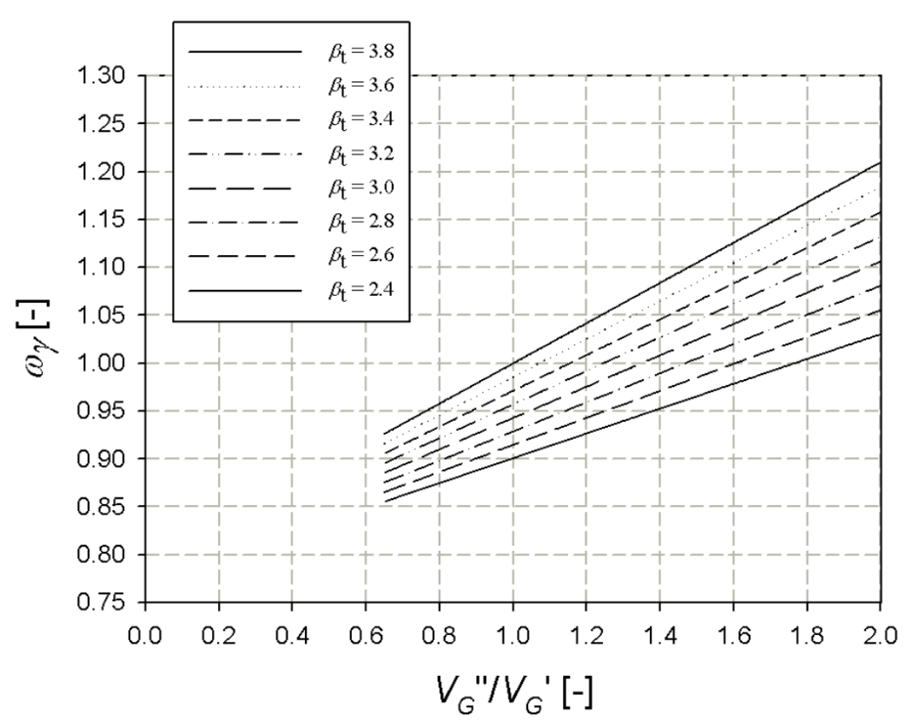
APFM: ADJUSTMENT FACTORS FOR PERMANENT ACTIONS
α_{E} = -0.7, β’ = 3.8, V_{x}’ = 0.10

Slide 91
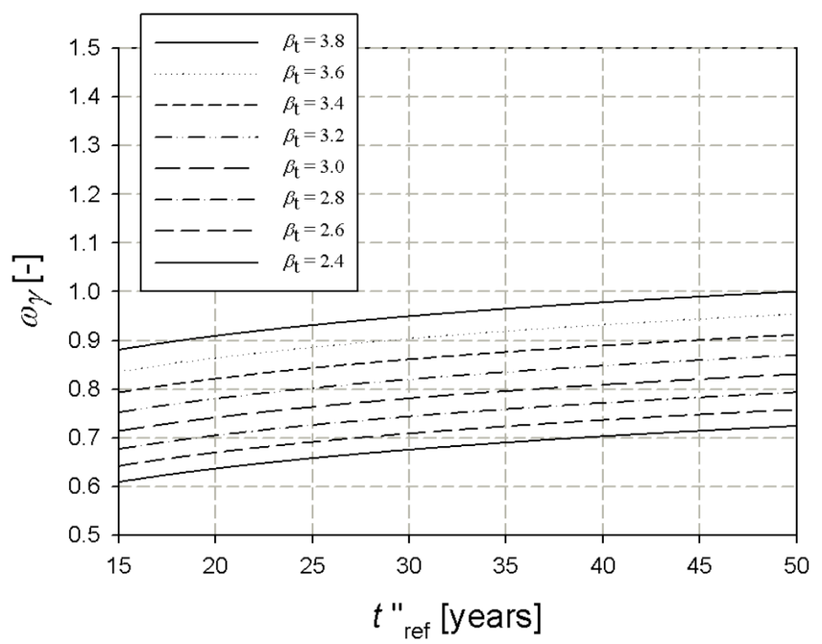
APFM: ADJUSTMENT FACTORS FOR IMPOSED LOADS
Q_{rep} = Q_{k}
(α_{E} = -0.7, β’ = 3.8, V”_{Qimp,50}= V’ _{Qimp,50} = 0.25)
β_{exist} ↓
Similar graphs for wind loads, snow loads and traffic loads

Slide 92
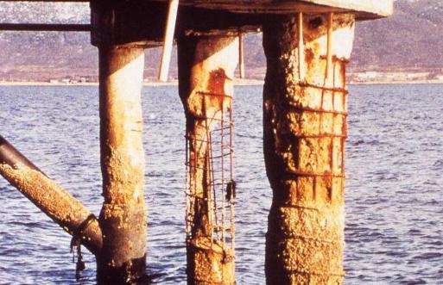

RECOMMENDED ASSESSMENT SCHEME
(INCREASING COMPLEXITY)
OK
APFM
not OK
OK
DVM
not OK
OK
Full-Prob
not OK
OK
Expt. Cost Opt.

Slide 93
CONCLUSIONS
MC 2020 will have 3 levels for target reliability:
  New structures
  Decision yes/no to upgrade
  Upgrading structures
Target reliability levels will be presented on an annual basis
Partial factors will be made compatible for both new and existing structures.
In the case of existing structures the partial factors will depend on the prescribed reliability level, the actual (measured) uncertainties and the remaining life time.

Slide 94
MODEL CODE 2020: CONTENTS PROPOSAL
 | MC2020 Part II: Actions on Structures
 | 10. Actions on structures

Slide 95
MODEL CODE 2020: CONTENTS PROPOSAL
MC2010 Part II: Design Input Data | MC2020 Part III: Design Input Data/Materials
5. Materials Imput data for contemporary materials concrete, reinforcing steel, prestressing steel, prestressing systems Non-metallic reinforcement, Fibres/fibre reinforced concrete | 11. Concretes
 | 12. Reinforcing steel
 | 13. Prestressing steel & prestressing systems
 | 14. Non-metallic reinforcement
 | 15. Fibre reinforced concrete & UHPC
 | 16. Protective materials & systems

Slide 96
MC2020 for Concrete Structure: Structural Materials
Structural materials
  Scope definition and range of applicability:
    conventional materials, old, novel and deteriorating materials incl. materials for interventions (repair mortars etc.)
  Assessment of material properties
    assumptions for design and assessment
  Taking advantage of information acquired by testing and monitoring
    tests methods to enable defined performance material design
    evaluation framework
    provisions for quality control

Slide 97
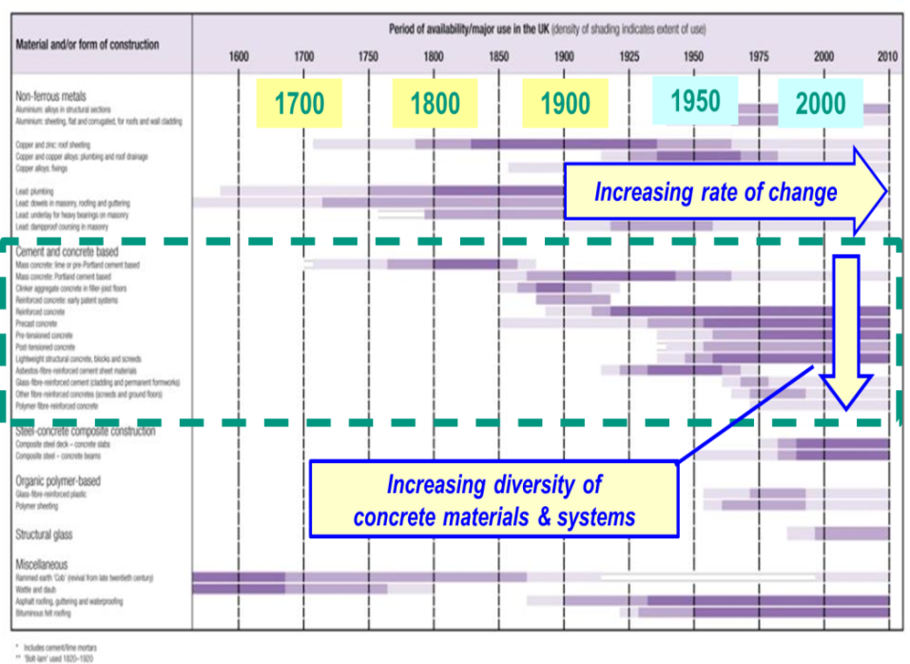
MC2020 for Concrete Structures
Structural materials
  Scope definition and range of applicability:
    conventional materials, old, novel and deteriorating materials incl. materials for interventions (repair mortars etc.)
  Assessment of material properties
    assumptions for design and assessment
  Taking advantage of information acquired by testing and monitoring
    tests methods to enable defined performance material design
    evaluation framework
    provisions for quality control

Slide 98
Some aspects related to the chapter
„Concrete“ in MC 2020
Harald S. Müller
fib TG10.1 Meeting
April 13/14, 2018
Lausanne, Switzerland

Slide 99


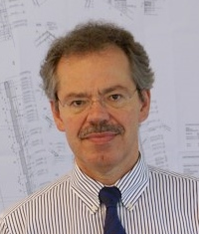


MC2020 – The challenge in contents and time
CEB-FIP MC 1990 – released 1993
Chapter 2.1: Concrete …
Main authors: Hilsdorf, Müller
drafts prepared
1986 - 1992
fib MC 2010 – released 2013
Chapter 5.1: Concrete
Main author: Müller
drafts prepared
2006 - 2012
fib MC 2020 – release 2021 !
Chapter 11: Concrete
Main authors: Müller, Dehn, … (small team!)
New initiative
drafts to be prepared
2018 - 2019 !
Model Code
2020

Slide 100

Ranges of applicability
Criterion
MC 1990
MC 2010
MC 2020
concrete strength
concrete type
20 … 60 (90) MPa
normal strength
20 … 130 MPa
normal strength
high strength
lightweight (10 … 90 MPa)
self-compacting
green (eco-concrete)
20 … 130 MPa
normal strength
high strength
lightweight (10 … 90 MPa)
self-compacting
green (eco-concrete)
UHPC (….250 MPa)
intervention materials
old concrete
concrete loads
different ranges of applicability, depending on the related load (static, impact etc.); temperature range: mainly 0 °C < T < 80 °C
tailor-made
concrete
reference to test standards or recommendations

Slide 101
New concepts and approaches for the chapter „Concrete“ in MC 2020
See presentation of Harald S. Müller, TG 10.1, Barcelona, Dec. 11-12, 2017
Summary of key points:
New types of future concretes → models are not available; conventional strength based concepts/models may not be applied!
→ performance based modelling is required (testing is mendatory)
Complex aging effects, depending on the sustained stress level and environ-mental actions, have to be considered (re-design of existing structures!)
Models upgrading → improvement due to advanced knowledge of today
→ improvement by integration of performance tests
→ interactions and coupled effects to be considered
(new binders, low binder content, new types of aggregate, …)

Slide 102
Classification of concrete with respect to modelling –
Proposed principle for MC 2020 (see Müller, Barcelona, 2017)
Conventional
concrete: NSC, HSC
Non-conventional
concrete
Concrete type
new
old
UHPC
ECO
other
Model
basis
strength
(grade)
strength (grade)
and / or
performance
concrete performance based on tests
binder
c [kg/m³]
w/c
aggregates
additions
admixtures
Validity ranges of strength- based models
CEM I
CEM II
CEM III
or
similar
normal/LWA
sand/gravel
acc. to
NS, CEN
or ISO
type,
amount
acc. to
NS, CEN
or ISO
type,
amount
acc. to
NS, CEN
or ISO
350
± 150
0.50
± 0.20

Slide 103
Testing of non-conventional concretes
Type of test ⃰ ⁾ | Test guideline | Scope of testing | Basis of modelling
Unit weight | EN 12390-7 | see guideline | -
Compressive strength | EN 12390-3 | see guideline | -
Strength development | EN 12390-3 | 3, 28, 180 days | eq. …. in MC 2020
Stress-strain behavior | EN 12390-5 | see guideline | -
High sustained loads | EN …. | stress level 0,7; 0,8; 0,9 | eq. …. in MC 2020
Creep and shrinkage | EN …. | see guideline | eq. …. in MC 2020
Tensile str. and fracture | RILEM CPC 7 | see guideline | eq. …. in MC 2020
Bond behavior | ….
Reinforcement corrosion | ….
Transport characterist. | ….
Durability behavior | ….
….
⃰ ) depending on the field of application of the concrete (see corresponding flow chard)

Slide 104
Example: Upgraded creep prediction in MC 2020
Creep model refinement
test data
adapted model: best fit
for ξ_{bc1}, ξ_{bc2}, ξ_{dc1}, ξ_{dc2}
adaption factors
equal 1.0 or determined by tests
Time-development functions refinement
model
Basic creep:
Drying creep:
Creep coefficient, φ
90 d < t-t_{s} < 120 d
adaption
factors
equal 1.0 or determined by tests
j
j+1
Duration of loading, t-t₀
log (t-t₀)
Accuracy gain through tests: Coefficient of variation drops from V ≈ 30 % to V ≈ 10 %
Notes:
104

Slide 105
Conclusions and outlook
A small project team will draft the chapter “Concrete” for MC 2020
It should be distinguished between conventional concrete (consolidated knowledge available) and non-conventional concrete
The classical strength based approach for modelling concrete behaviour will be amended by new performance based modelling approaches
A first draft of the chapter “Concrete” will be ready by the end of the year 2018 to meet the MC 2020 release deadline

Slide 106
MC 2020 - Chapter 12.XX „Part Durability“
Frank Dehn

Slide 107
Model Code 2010 - status quo
Chapter
Title
Content
5.1.12
Transport of liquids and gases in hardened concrete
Material laws
(constitutive)
5.1.13
Properties related to durability
Models
(deterioration, prediction)
7.8
Verification of limit states associated with durability
- Limit state definition
- Limit state function
- Design models

Slide 108
Model Code 2020 - new chapters
Contents of the new chapters 12.XX and 25.XX (excerpt)
12.XX Properties related to transport of liquids and gases in hardened concrete
12.XX Properties related to durability
12.XX Evaluation of performance of non-conventional concretes
12.XX Assumptions used for (durability) design
25.XX Evaluation of condition limit states (CLS) associated with durability
Separation: input data for materials / CLS associated with durability

Slide 109
Material parameters
Description of material behaviour
Material law
Assumption used for (durability) design
Material laws / assumptions used for (durability) design contain
material parameters (e.g. diffusion coefficient)
Material parameters require their consideration within chapter 12.XX

Slide 110
Needed extensions of the materials chapter
Description of known (and accepted, if available) testing procedures for the
determination of material parameters (e.g. diffusion coefficient for carbonation,
chloride ingress, …)
Extension of known (and accepted, if available) testing procedures by taking into
account:
  cracked concrete (e.g. chloride ingress in cracked concrete)
  coupled exposure conditions (e.g. carbonation, chloride ingress, frost etc.)
  new concretes (e.g. fibre-reinforced concrete, GP, etc.)
  “historical” concretes
  ….
Definition of material parameters for material laws and assumptions for
(durability) design & description of testing procedures for material parameters

Slide 111
MC2020 for Concrete Structures
Reinforcing steel
Prestressing steel
Prestressing systems
  Scope definition and range of applicability:
    include old reinforcing materials and systems, corrosion resistant reinforcement
  Assessment of material and system properties
    effect of deterioration on the properties of reinforcing steel & prestressing steel
    behaviour of reinforcing steel after cooling
    time dependent losses for old materials
  Taking advantage of information acquired by testing and monitoring
    evaluation framework for assessment
    situ measuring techniques to determine present prestressing level

Slide 112
MC2020 for Concrete Structures. Non-Metallic Reinforcement
Non-metallic reinforcement
  Scope definition and range of applicability:
    include FRP rebars and externally applied reinforcement, include textile reinforcement
  Assessment of material properties
    properties related to durability of non-metallic reinforcement
  Design and execution guidance
    Include assumptions used for design incl. stochastic approach and treatment/determination of safety factors

Slide 113

MC2020 for Concrete Structures. Non-Metallic Reinforcement
Non-metallic reinforcement
  Scope definition and range of applicability:
    include FRP rebars and externally applied reinforcement, include textile reinforcement
  Assessment of material properties
    properties related to durability of non-metallic reinforcement
  Design and execution guidance
    Include assumptions used for design incl. stochastic approach and treatment/determination of safety factors

Slide 114
MC2020 for Concrete Structures. Fibres/Fibre Reinforcement Concrete
Fibres/Fibre Reinforced Concrete
  Scope definition and range of applicability:
    include UHPFRC (consistent design recommendations for all FRC’s)
  Assessment of properties of fibre reinforced concrete
    taking advantage of information acquired by testing and monitoring
    test methods for the determination of FRC properties
    durability of steel fibres in concrete
    constitutive laws incl. creep and fatigue
  Behaviour in shear without conventional reinforcement
  (incorporation in shear model for ordinary RC)

Slide 115


MC2020 for Concrete Structures. Fibres/Fibre Reinforcement Concrete

Slide 116
MODEL CODE 2020: CONTENTS PROPOSAL
MC2010 Part II: Design Input Data | MC2020 Part III: Design Input Data/Interfaces
6. Interface characteristics Imput data for contemporary materials bond of embedded steel reinforcement, bond of non-metallic reinforcement, concrete to concrete, concrete to steel. | 17. Bond of embedded steel reinforcement
 | 18. Bond of embedded non-metallic reinforcement
 | 19. Bond of externally applied reinforcement
 | 20. Concrete to concrete
 | 21. Concrete to steel
 | 22. Anchorages in concrete

Slide 117
MC2020 for Concrete Structures. Interfaces
Concrete to concrete
Concrete to steel
  Scope definition and range of applicability:
    include new material for interventions
    interaction of new concrete to old concrete
    include mechanical interlock not fulfilling current provisions

Slide 118
MC2020 for Concrete Structures. Interfaces
Bond of embedded steel reinforcement
Bond of prestressing rebars
Bond of non-metallic reinforcement
  Scope definition and range of applicability:
    bond provisions for existing structures and structures under severe conditions
      bond of old and of new materials, bond of post-installed rebars, bond of externally applied reinforcement
      effect of deterioration on bond
      bond in case of repair action
      bond in seismic joints of existing and new structures
      interaction of bond-corrosion-fatigue
      long term performance
  Performance specifications for laps and anchorages
    attention for simplified provisions (level of approximation)

Slide 119
MODEL CODE 2020: CONTENTS PROPOSAL
MC2010 Part III: Design | MC2020 Part IV: Design and Assessment Procedures
7. Design procedure conceptural design, structural analysis and dimensioning, design verification, detailing incl. fastenings | 23. Conceptual approach to design and assessment
 | 24. Structural analysis and dimensioning
 | 25. Evaluations of structural performance
 | 26. Evaluation of environmental quality
 | 27. Evaluation of economic efficiency

Slide 120
MC2020 for Concrete Structures. Conceptual Design
  Scope definition :
    consider implications of conceptual approach for assessment,
    Treatment of sustainability and through-life care
    Strategies for design and assessment (incl. reasoning in applying surveys, testing and monitoring) and consequences of those for verification strategies

Slide 121

THE DOME OF THE PANTHEON AND SAINT PETER’S BASILICA. 2nd Century (125-128) AD

Slide 122








EDUARDO TORROJA (1899-1961)

Slide 123



CONCEPTUAL DESIGN: GENERAL PROCESS

Slide 124

SANTOS VIADUCT

Slide 125

SANTOS VIADUCT

Slide 126


SANTOS VIADUCT

Slide 127

PROBABILISTIC APPROACH TO REBAR CORROSION. fib MODEL CODE FOR SERVICE LIFE DESIGN

Slide 128


Slide 129
CONCEPTUAL DESIGN: GENERAL PROCESS

Slide 130
SANTOS VIADUCT
Adopted cross-section
Notes:
Quitar en la parte de arriba definitions

Slide 131
SANTOS VIADUCT
External prestressing

Slide 132

SANTOS VIADUCT

Slide 133

SANTOS VIADUCT

Slide 134

7.3 Verification/design of/for structural safety (ULS) for predominantly static loading
MC2020 for Concrete Structures Design and Assessment
Shear and Punching
  Improved models for shear and punching:
  Differentiation of shear level I-III models for different types of structures
  Shear capacity of circular cross-sections
  Influence of fatigue in shear and punching behaviour
  Implementation of compressive membrane action in punching resistance
  Influence of type of steel (A, B, C, D), plain or ribbed on shear behavior, old types of reinforcement, alternative types of concrete, deteriorated materials
  Effect of insufficient reinforcement
  Shear resistance models in presence of external prestressing
  Verification methods need to be generalized to accommodate
  not only steel reinforcement but also non-metallic reinforcement,
  steel fibre reinforcement as far as appropriate

Slide 135
MC2020 for Concrete Structures. Verification/design of/for structural safety (ULS) for predominantly static loading Design
Shear and Punching
  Improved models for shear and punching:
  Differentiation of shear level I-III models for different types of structures
  Shear capacity of circular cross-sections
  Influence of fatigue in shear and punching behaviour
  Implementation of compressive membrane action in punching resistance
  Influence of type of steel (A, B, C, D), plain or ribbed on shear behavior, old types of reinforcement, alternative types of concrete, deteriorated materials
  Effect of insufficient reinforcement
  Shear resistance models in presence of external prestressing
  Verification methods need to be generalized to accommodate
  not only steel reinforcement but also non-metallic reinforcement,
  steel fibre reinforcement as far as appropriate

Slide 136
MC2020 for Concrete Structures. Verification of structural safety (ULS) for extreme thermal conditions
Fatigue
  Fatigue strength (life) of members subjected to shear: shear strength beam without shear reinforcement, shear strength of slab, shear strength of beam with shear reinforcement, effect of travelling loads, effect of moisture, effect of freeze thaw cycles
  Fatigue in combination with corrosion
  Fatigue for new materials
Impact and explosion
Seismic
  Seismic design and assessment incl. seismic retrofitting
  Seismic resistance of precast concrete structures
  Design for resilience
Fire
Cryogenic conditions

Slide 137

MC2020 for Concrete Structures.

Slide 138
MC2020 for Concrete Structures. Verification of limit states associated with durability
Durability and Service Life Prediction
  Change approach from design by avoidance (proxi limit states criteria) to evaluation or design for (residual) life time (new limit state criteria)
  Introduce of new limit state concept for existing structures with damages beyond limit state of new structures, which can be based on structural performance rather than material condition
  Introduce propagation models (need for models or tests with reproducible results) including the effects of interventions Introduce evaluation of reliability and durability for deteriorating structures
  Include updating of reliability and durability for deteriorating structures by use of information from in-situ testing and monitoring Include durability assessment after intervention / repair
  Extension of models for durability to various forms of deterioration. Carbonation-induced corrosion. Chloride-induced corrosion. Freeze-thaw attack. Acid attack. Sulphate attack

Slide 139

MC2020 for Concrete Structures. Verification of limit states associated with durability

Slide 140

MC2020 for Concrete Structures
to achieve the intended design service-life of structure
to facilitate an extension of life / change of use of structure
to minimise through-life cost and environmental impacts

Slide 141

MC2020 for Concrete Structures. Robustness
Robustness
  Clear definition of the concept of robustness and its limitations
  Introduction of redundancy as a design criterion
  Difference between assessment and design

Slide 142
MC2020 for Concrete Structures. Robustness
Robustness
  Clear definition of the concept of robustness and its limitations
  Introduction of redundancy as a design criterion
  Difference between assessment and design

Slide 143
MC2020 for Concrete Structures. Verification assisted by monitoring and testing
  Monitoring of durability and performance
    Locations for surveys, testing and monitoring activities
    Condition survey and monitoring activities
    Tools and techniques for surveys and monitoring
    Gathering data for condition control purposes
    General flow of condition survey process
    Automated monitoring of concrete structures
    Automated monitoring and updating of service life prediction
  Data evaluation and incorporation of a priori knowledge
  Consideration of past performance as evidence of suitability for future performance
  Provisions for proof loading of structures
  Monitoring systems related to service life
  Value of information

Slide 144
MC2020 for Concrete Structures. Verification assisted by monitoring and testing

Slide 145
MC2020 for Concrete Structures. Detailing
  Improved background for detailing provisions and provide more rational detailing models
  Scope extension:
    structures after intervention and/or with special structural details / special materials
    detailing of connections between new concrete and old concrete
    behaviour and strength of badly detailed existing structures

Slide 146
MODEL CODE 2020: CONTENTS PROPOSAL
MC2010 Part IV: Construction | MC2020 Part V: Execution
8. Construction New works Execution management Reinforcing Steel Works Prestressing Works Non-metallic reinforcement Falsework and formwork | 28. Execution management
 | 29. Construction works
 | 30. Execution of interventions

Slide 147

MC2020 for Concrete Structures. Construction
Construction works: new works and works on existing structures
  Scope
    include maintenance and interventions
    include post casting treatments
    include provision for FRC & UHPC, new cementitious materials
    consider implications of BIM and relation with Quality and Information Management
  • Reference to ISO Execution Standard as far as appropriate

Slide 148
MC2020 for Concrete Structures. Construction
Construction works: new works and works on existing structures
  Scope
    include maintenance and interventions
    include post casting treatments
    include provision for FRC & UHPC, new cementitious materials
    consider implications of BIM and relation with Quality and Information Management
  • Reference to ISO Execution Standard as far as appropriate

Slide 149
MODEL CODE 2020: CONTENTS PROPOSAL
MC2010 Part V: Conservation | MC2020 Part VI: Through-life Management
9. Conservation Provisions for condition assessment, evaluation, decisión-making & interventions. | 31. Conservation

Slide 150

MC2020 for Concrete Structures. Through-life management & care

Slide 151
MODEL CODE 2020: CONTENTS PROPOSAL
MC2010 Part VI: Dismantlement | MC2020 Part VII: Dismantlement and Reuse
10. Dismantlement | 32. Dismantlement and reuse

Slide 152
MC2020 for Concrete Structures. Dismantlement, repurposing, reuse and recycle
  Scope
    Include safety level / safety management for dismantling
    Elaborate structural aspects of dismantlement (dismantlement of parts, dismantlement of prestressed structures, repair of accidently cut tendons)
    Include reflective thinking approach / review of proposed dismantlement concept and approach

Slide 153

MC2020 for Concrete Structures. Dismantlement, repurposing, reuse and recycle

